Slide 1
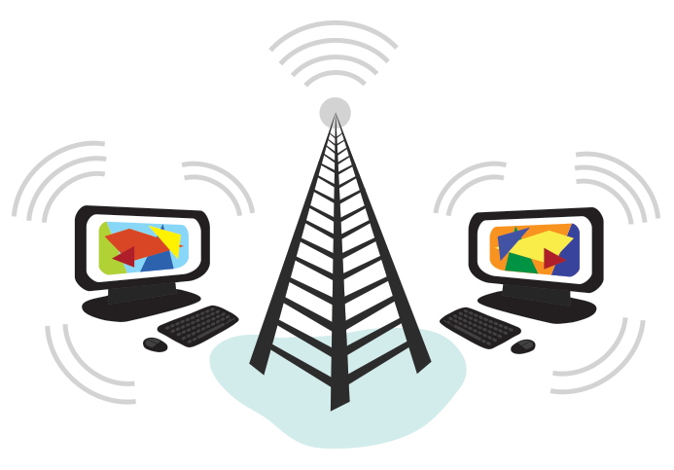
What is the Internet?
Anoud Shaikh
Subject: IICT

Slide 2
Introduction
The Internet is an increasingly important part of everyday life for people around the world.
With the Internet, it's possible to access almost any information, communicate with anyone else in the world, and do much more.

Slide 3
Internet:
The Internet is a global network of billions of computers and other electronic devices.
Connecting a computer to the Internet is also called going online.
When someone says a computer is online, it's just another way of saying it's connected to the Internet.

Slide 4
World Wide Web
The World Wide Web—usually called the Web for short—is a collection of different websites you can access through the Internet.
The purpose of a website can be almost anything: a news platform, an advertisement, an online library, a forum for sharing images, or an educational site

Slide 5
Difference between Internet and WWW
Most of us use the words web and internet to mean the same thing but they're actually quite different.
The world wide web, or web for short, are the pages you see when you're at a device and you're online.
But the internet is the network of connected computers that the web works on, as well as what emails and files travel across.
Think of the internet as the roads that connect towns and cities together. The world wide web contains the things you see on the roads like houses and shops.
And the vehicles are the data moving around - some go between websites and others will be transferring your emails or files across the internet, separately from the web.

Slide 6
Web Browser
Once you are connected to the Internet, you can access and view websites using a type of application called a web browser.
Just keep in mind that the web browser itself is not the Internet; it only displays websites that are stored on the Internet.

Slide 7
Web Browser (Contd.)
A web browser (commonly referred to as a browser) is a software application for accessing information on the World Wide Web.
When a user requests a web page from a particular website, the web browser retrieves the necessary content from a web server and then displays the page on the user's device.
To connect to a website's server and display its web pages, a user must have a web browser installed.

Slide 8
Web Server
The primary function of a web server is to store, process and deliver web pages to clients.
A server is a computer that serves information to other computers. These computers, called clients, can connect to a server through either a local area network or a wide area network, such as the internet. ... There are many different types of servers, including Web servers, mail servers, and file servers.

Slide 9
Computer Server (contd.)
A server doesn't have the screen or keyboard. And although your computer stores files and data you've put on it, a server stores all the data associated with the websites that are hosted by it and shares that info with all computers and mobile devices (like yours) that need to access them.

Slide 10
What can you do Online?
There's almost no limit to what you can do online.
The Internet makes it possible to quickly find information, communicate with people around the world, manage your finances, shop from home, listen to music, watch videos, and much, much more.

Slide 11
Finding information online
With billions of websites online today, there is a lot of information on the Internet.
Search engines make this information easier to find. All you have to do is type one or more keywords, and the search engine will look for relevant websites.
There are many different search engines you can use, but some of the most popular include Google, Yahoo!, and Bing.

Slide 12
Email
Short for electronic mail, email is a way to send and receive messages across the Internet.
Almost everyone who uses the Internet has their own email account, usually called an email address.
This is because you'll need an email address to do just about anything online, from online banking to creating a Facebook account.

Slide 13
Social networking
Social networking websites are another way to connect and share with your family and friends online.
Rather than sharing with just a few people over email, social networks make it easier to connect and share with many people at the same time.
Facebook is the world's largest social networking site, with more than 1 billion users worldwide.

Slide 14
Chat and instant messaging
Chat and instant messaging (IM) are short messages sent and read in real time, allowing you to converse more quickly and easily than email.
These are generally used when both (or all) people are online, so your message can be read immediately.
By comparison, emails won't be seen until recipients check their inboxes.

Slide 15
Online media
There are many sites that allow you to watch videos and listen to music.
For example, you can watch millions of videos on YouTube or listen to Internet radio on Pandora.
Other services, like Netflix and Hulu, allow you to watch movies and TV shows.

Slide 16
Everyday Tasks
You can also use the Internet to complete many everyday tasks and errands.
For example, you can manage your bank account, pay your bills, and shop for just about anything.
The main advantage here is convenience.
Rather than going from place to place, you can do all of these tasks at home!

Slide 17
The main difference between MAC and IP address is that, MAC Address is used to ensure the physical address of computer. It uniquely identifies the devices on a network.
While IP address are used to uniquely identifies the connection of network with that device take part in a network.

